Slide 1
Cat and Dog Image Classification
By: Calvin Tran, Soleil St Louis, Muhammad Khan, Prahalad Muralidharan

Slide 2
Objective
Build a CNN network to classify Dogs and Cats using a pre-trained model w/ VGG16 and a 5-layer CNN model.
Be able to visualize the features for each model using the Grad-Cam method and Saliency Map.
Comparison between VGG16 and the 5-layer CNN model.

Slide 3
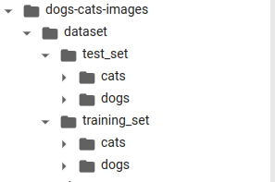
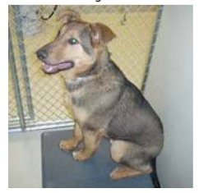
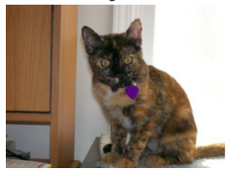
Our data
The training set is a balanced set of 8000 images.
The testing set is a balanced set of 2000 images.
So in total, we have 10000 images.

Slide 4
KNN Model
Pre-Process the Data
Change the Images into numpy Array and create 2 arrays one with only raw pixel data and another that extracts the color from the image to classify
Split the Data into Training(80%) and Validation(20%)
Finding the Best K:
Use the Optimal Value and test it on the validation set
For each value of k that you want to test, perform the following steps:
Train the KNN model with k-fold validation
Calculate the accuracy of the model on this fold.
Calculate the average accuracy of the model across all folds for each value of k.
Choose the value of k that gives the highest average accuracy as the optimal value.
Use the Optimal Value and test it on the validation set.

Slide 5
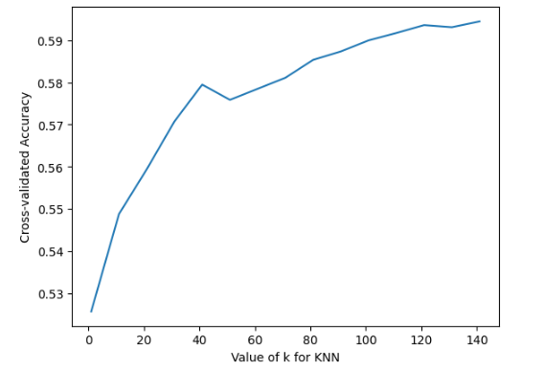
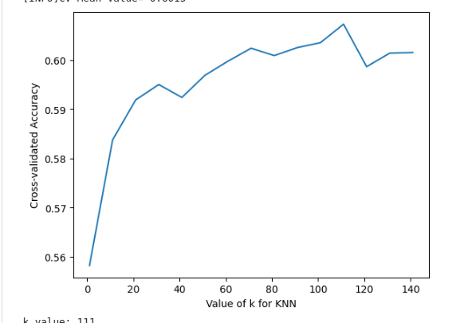
KNN - Finding the Best K
To lower the time complexity, we did increments of 20 from 1 to 141.
Raw Pixel Data 49152 pixel vs Feature Data with only 512 features to calculate
For each K value, we set the fold to be 5.
Raw Pixel Data
Color Features Data

Slide 6
KNN - Validating our model
From k = 70+ is when it starts to converge and reached the most optimal point and starts to oscillate. It’s hard to choose the “Best” k, so to strike a balance between bias and variance, using square root of training size is good.
Sqrt(8000) ≈ 89. Keep it odd to remove ties
Feature scores a little bit better, but not the best because colors are in both animals. Maybe it little bit overfit to the data as well because there may be more brown dogs than cats?
Raw Pixel Data
Color Features Data

Slide 7
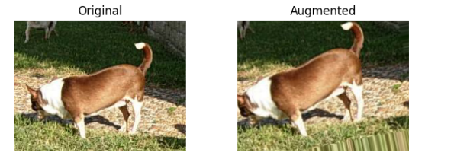
CNN Model - Pre-Process the Data
#Generate Real-Time Batches of Augmented Images for Training
train_datagen = ImageDataGenerator(rotation_range=15,
rescale=1./255,
shear_range=0.1,
zoom_range=0.2,
horizontal_flip=True,
width_shift_range=0.1,
height_shift_range=0.1,
)
#Generate Real-Time Batches of Augmented Images for Training
validation_datagen = ImageDataGenerator(rescale=1./255)
Don’t need to augment the image since its only validating

Slide 8
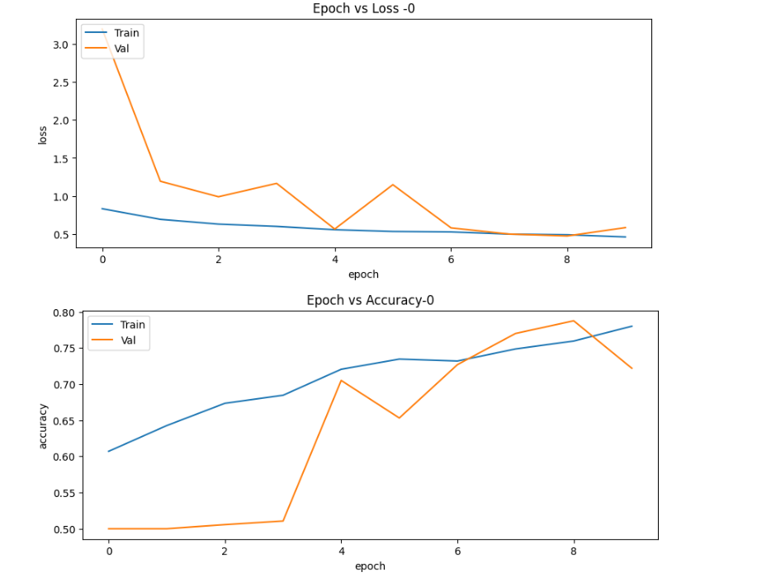
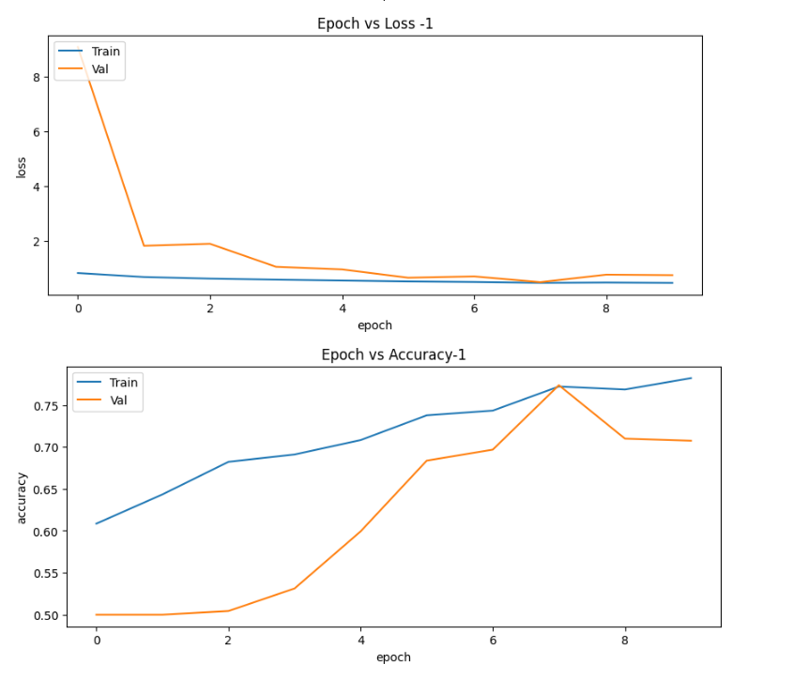
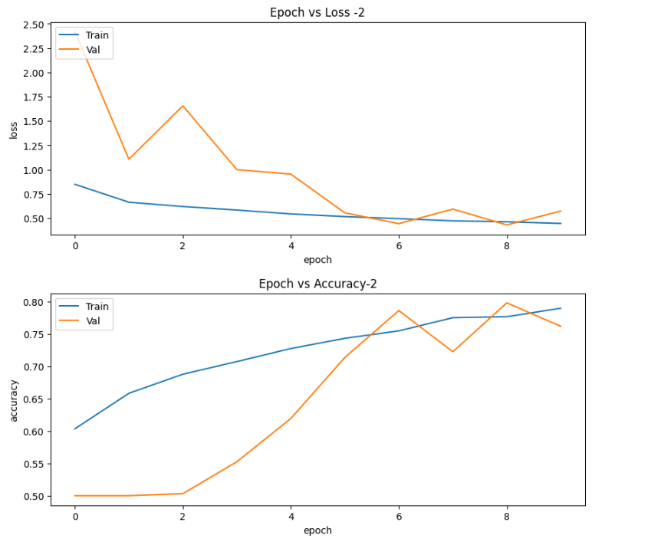
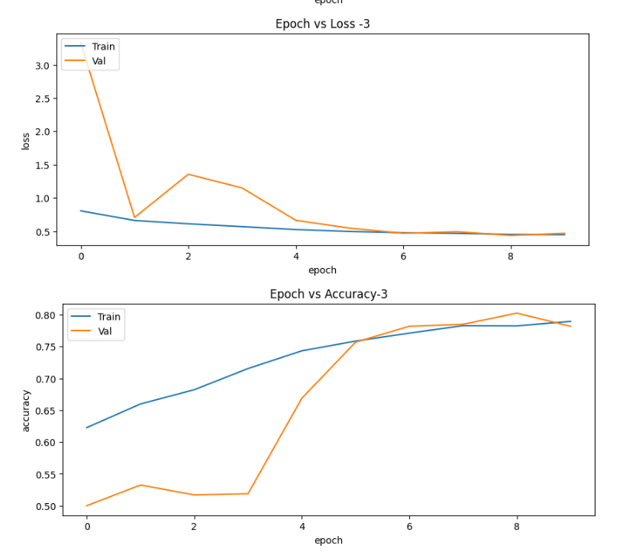
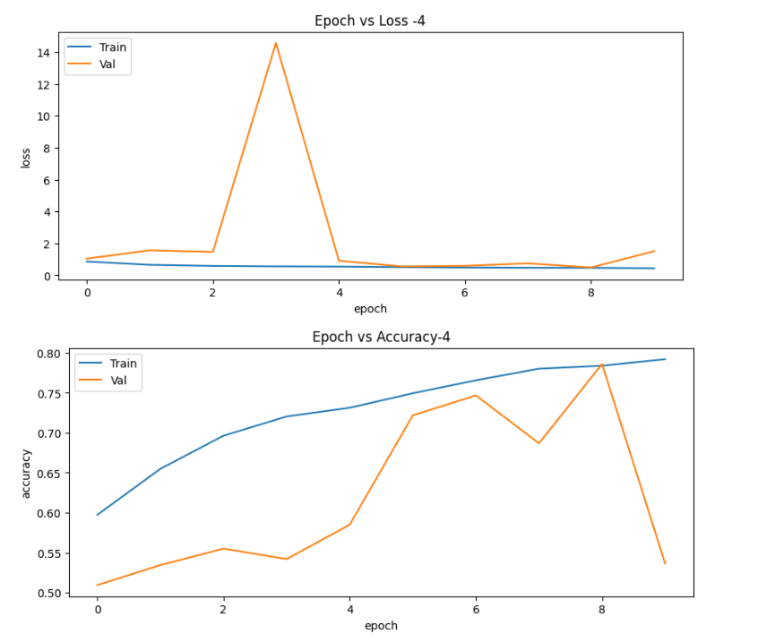
CNN Model - 5 Layer CNN Model

Slide 9
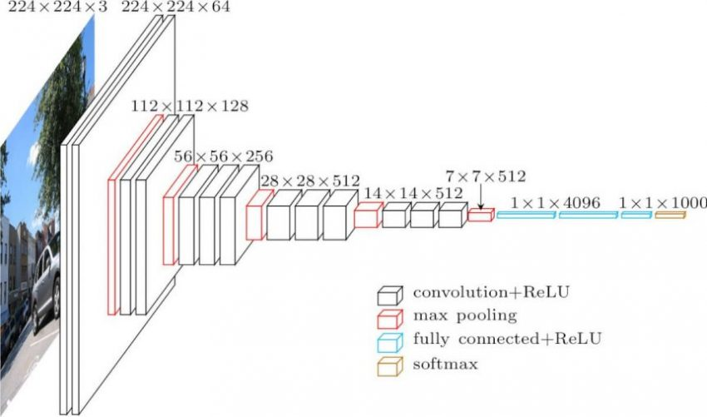
CNN Model - Using Pre-Trained Model w/VGG16
Architecture of the VGG16
128 x 128
Flatten the last layer into 1D.
Create a dense layer with 128 nodes as weights to train on.
The last layer classified with sigmoid
Set as Non-trainable
To validate our model, we use 5-folds cross validation. Each fold will run 10 epoch on the model
Our loss function is binary_crossentropy.
We are using Adam(Adaptive Moment Estimation) as the optimizer, extension to stochastic gradient descent, where it does not have a fixed learning rate.

Slide 10
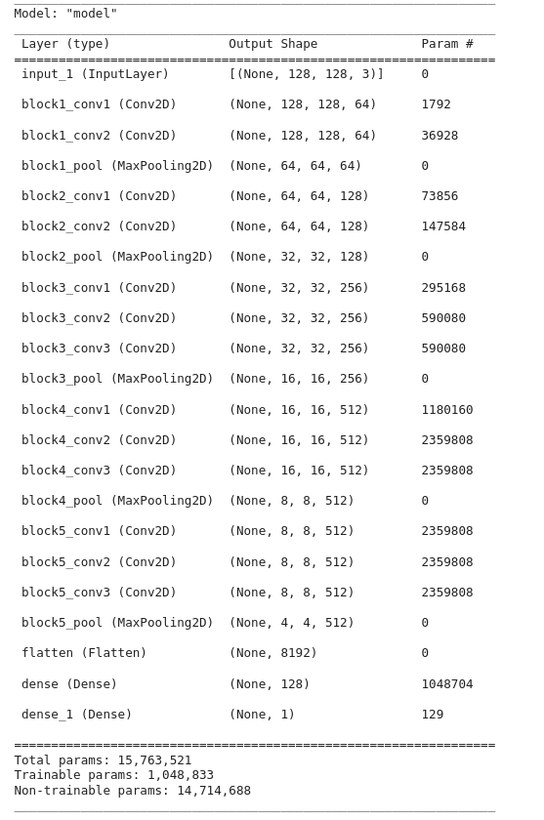
VGG16 Model.summary()

Slide 11
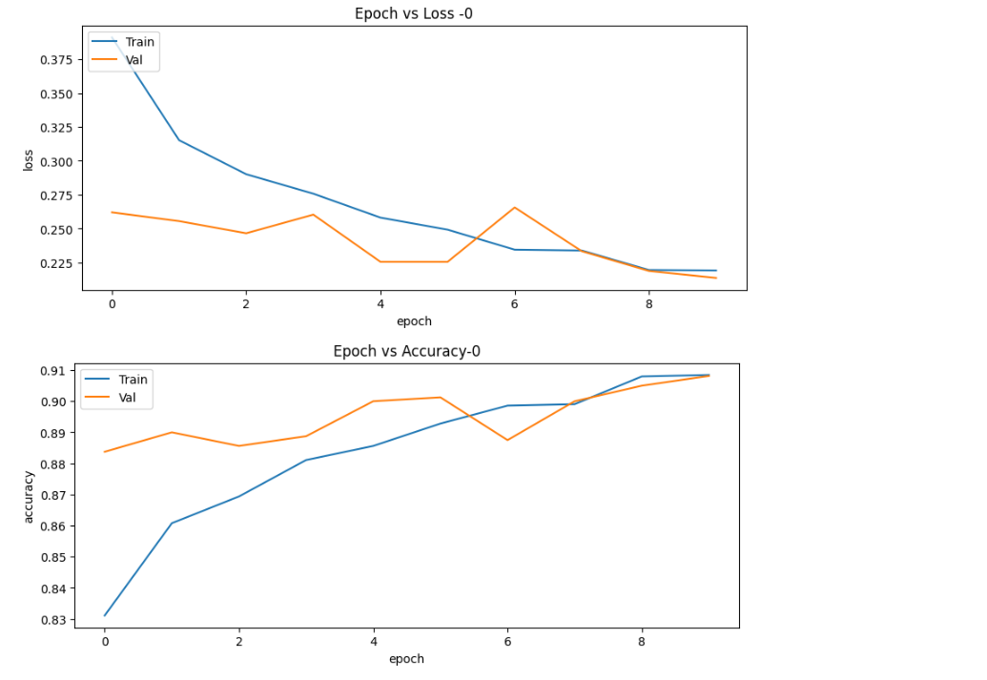
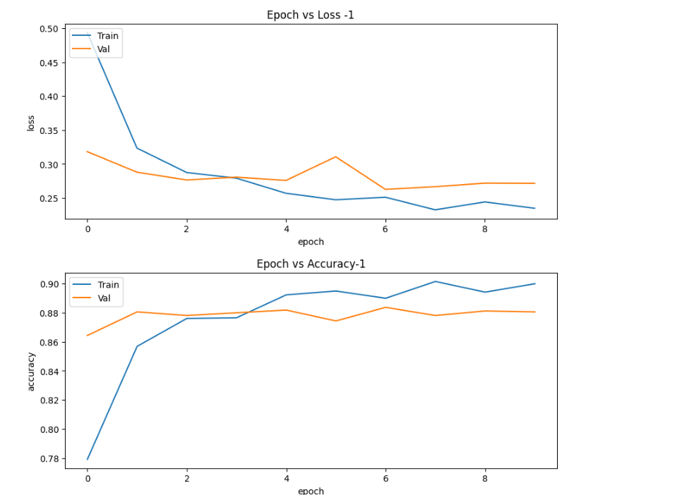
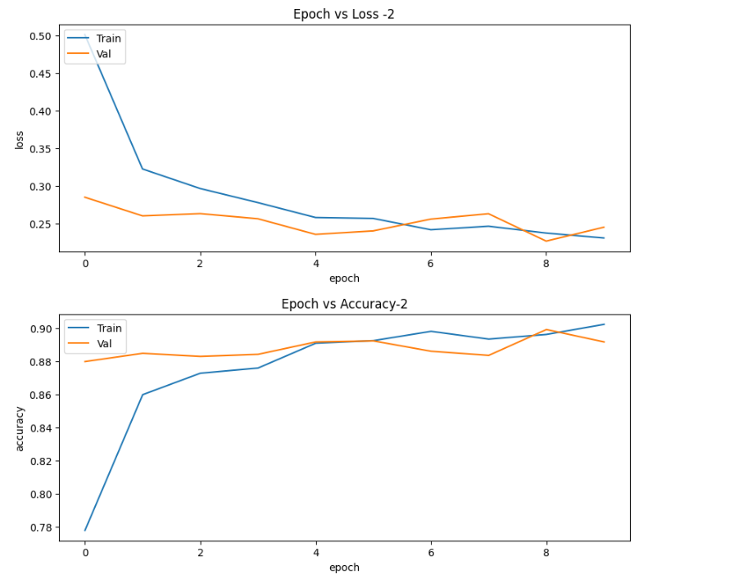
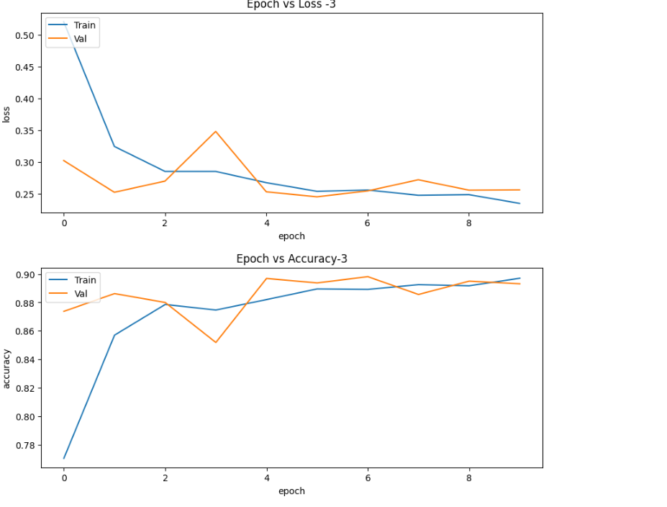
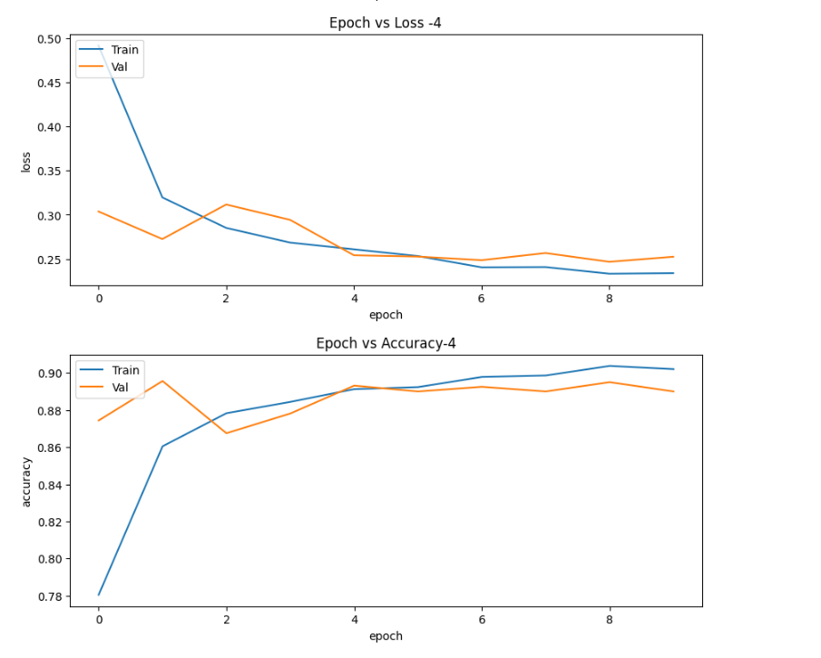
CNN Model - VGG16

Slide 12
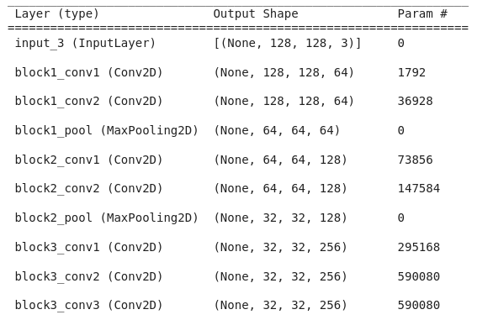
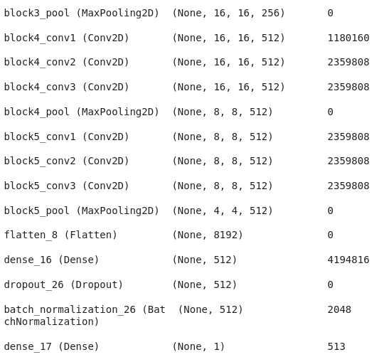
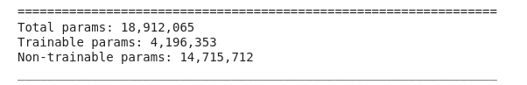
CNN Model - VGG16 Regularization Model Summary

Slide 13
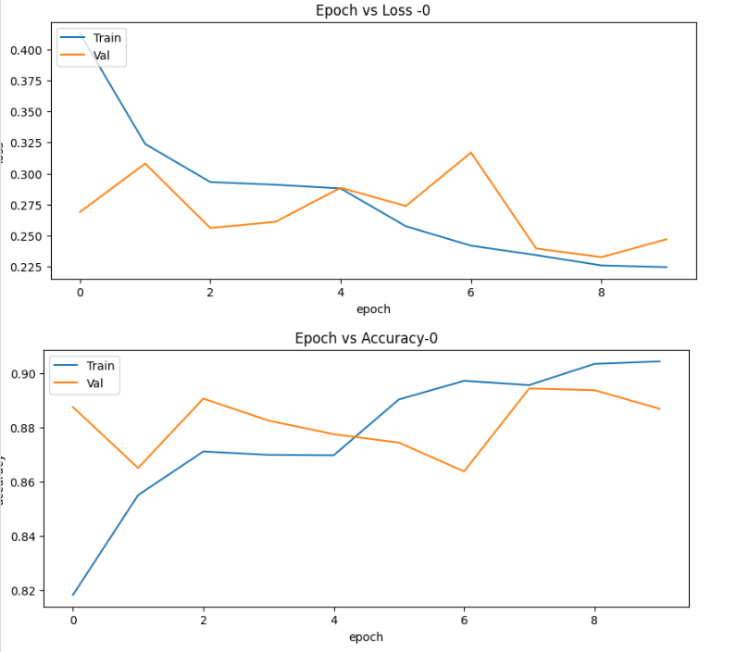
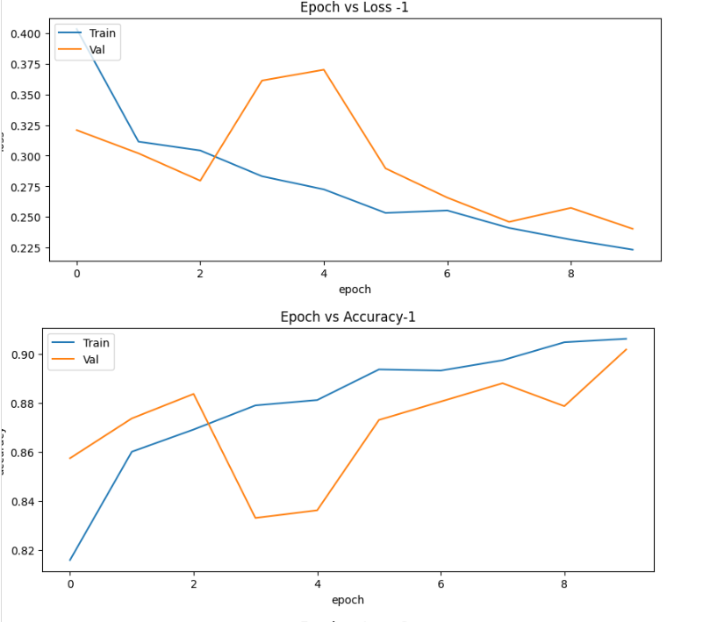
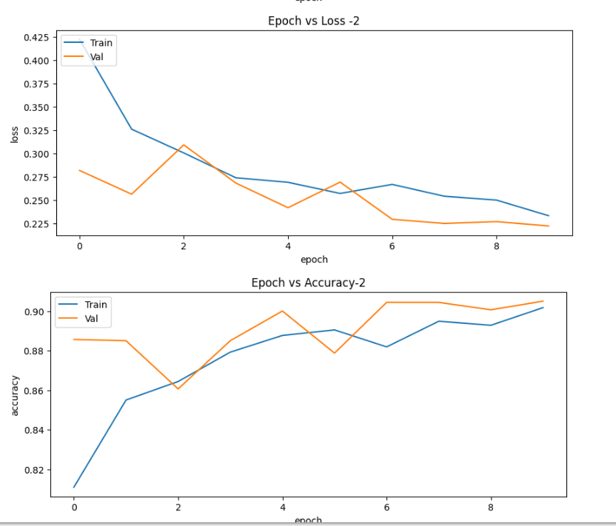
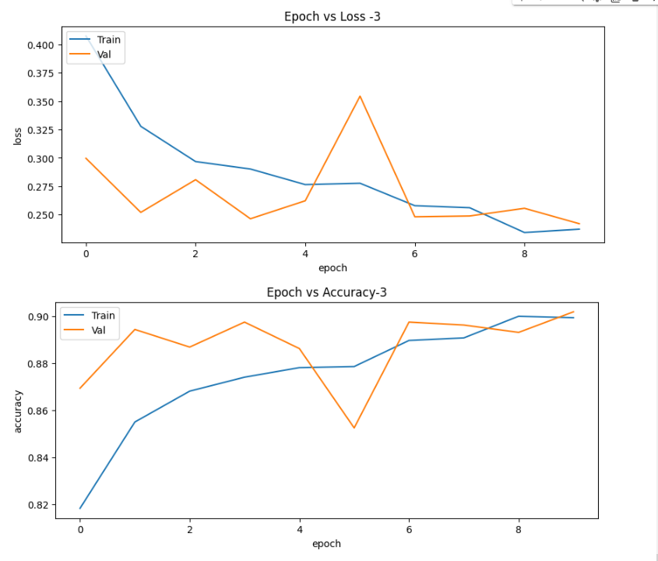
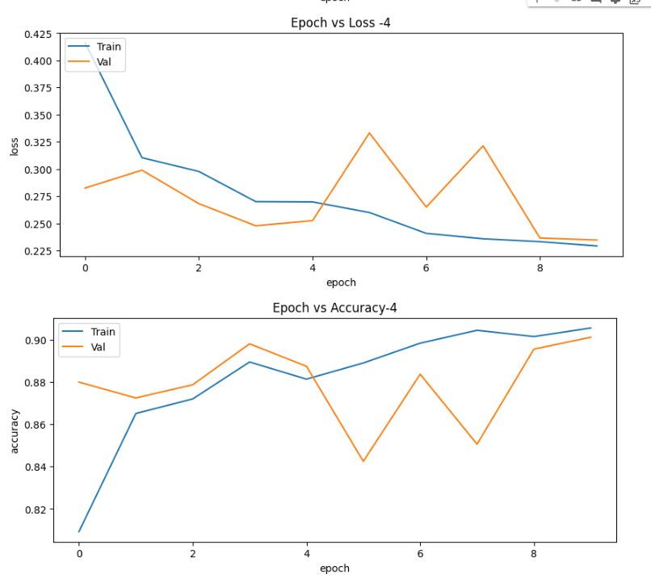
CNN Model - VGG16 Regularization

Slide 14
Problem with the CNN Models
5-Layer Model: Low training and validation accuracy score meaning that the model is not complex enough. Since in this model, we are not using transfer learning, the model is using a small dataset to train on therefore causing a low accuracy.
Sometimes on each folds the model is overfitting

Slide 15
CNN - Validate Across all Models on Testing set
Fold | CNN Model (Test Acc) | VGG16_R (Test Acc) | VGG16_NoR (Test Acc)
0 | 0.7405 | 0.8920 | 0.8960
1 | 0.7080 | 0.9025 | 0.8930
2 | 0.7660 | 0.8955 | 0.8920
3 | 0.7890 | 0.8940 | 0.8945
4 | 0.5340 | 0.8940 | 0.8960

Slide 16
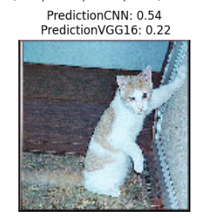
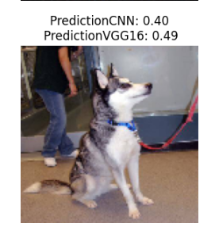
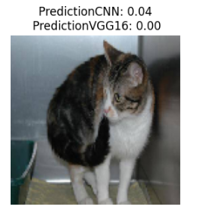
Model Predicting Images

Slide 17
What is Grad-Cam?
Grad-CAM is a popular technique for creating a class-specific heat-map based off of a particular input image, a trained CNN, and a chosen class of interest.
visualizes where a convolutional neural network model is looking.
closely related to CAM.
Grad-CAM can be calculated on any CNN architecture as long the layers are differentiable.
The Grad-CAM technique utilizes the gradients of the classification score with respect to the final convolutional feature map, to identify the parts of an input image that most impact the classification score.
Notes:
Classification score - any score or metric the algorithm is using (or the user has set) that is used in order to compute the performance of the classification.
the ratio of number of correct predictions to the total number of input samples
The gradCAM function computes the importance map by taking the derivative of the reduction layer output for a given class with respect to a convolutional feature map.
the heat-map for this layer should display the most accurate visual explanation of the object being classified by the model.

Slide 18
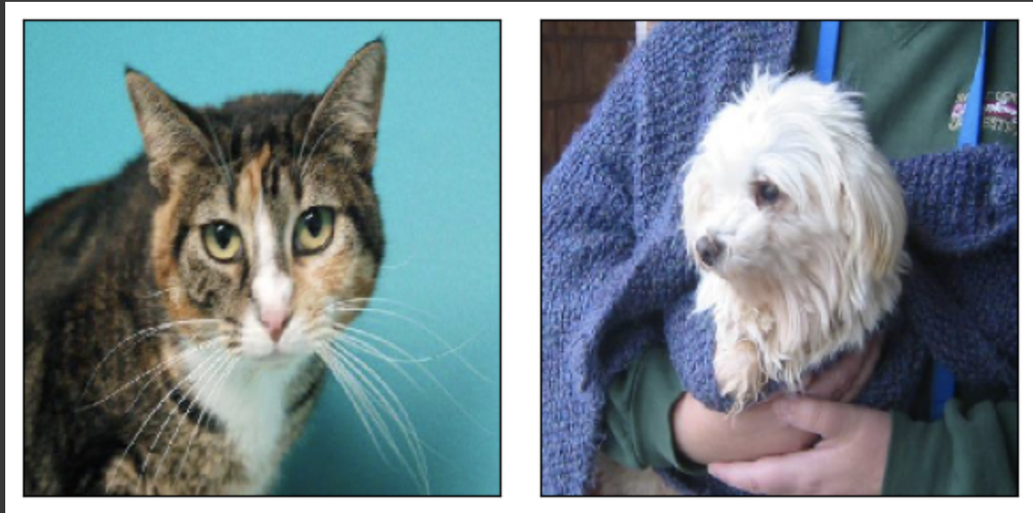
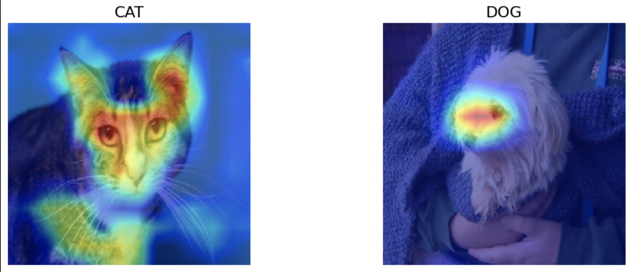
Grad-Cam Output with VGG16 Model
Notes:
The upper face of the dog has the greatest impact on the classification.
The upper face, ears, an d chest of the cat has the greatest impact on the classification

Slide 19
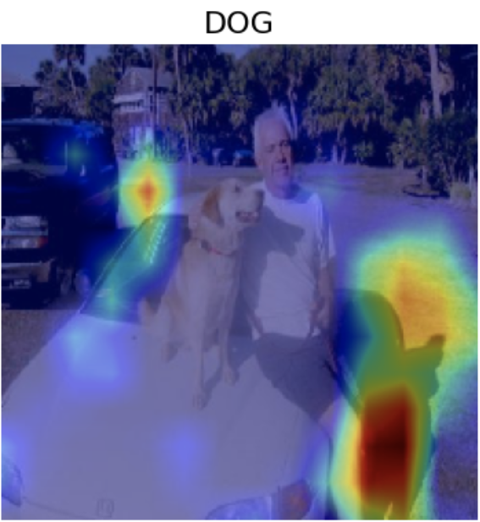
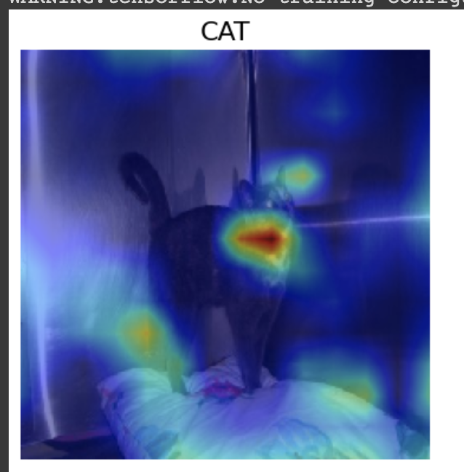
Problems with Grad-Cam
Notes:
Although Grad-CAM is supposed to be able to explain what regions of an image a model used for prediction, it turns out that Grad-CAM is not guaranteed to do this! In brief, because of the gradient averaging step, Grad-CAM’s heat maps do not reflect the model’s computations and can highlight irrelevant areas that weren’t used for prediction.

Slide 20
What is a Saliency Map?
Saliency map is an explanation method used for interpreting the predictions of convolutional neural networks (CNNs).
The saliency map of an input image specifies parts of it that contribute the most to the activity of a specific layer in the network, or the decision of the network as a whole.
computes the effect of each pixel on the final prediction then generates a map that describes the important pixel that have influenced the prediction.

Slide 21
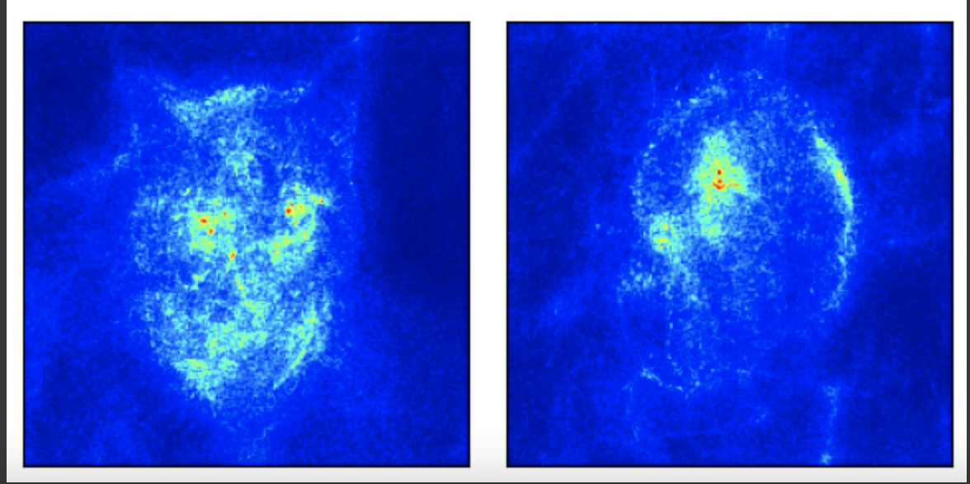
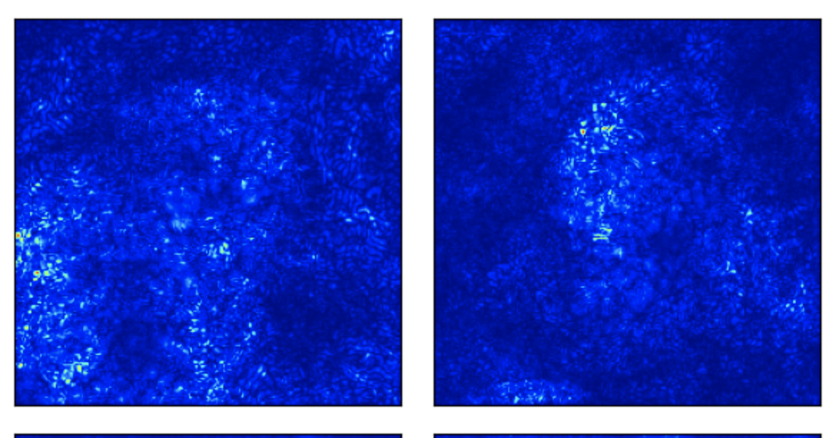
Saliency Map Output with VGG16 Model
Notes:
For example, according to saliency map output, prediction of the cat is highly influenced by the pixels near the eyes and bottom half of the face. Prediction of the dog is highly influenced by the pixels around the eyes, nose, and ear.

